Slide 1
Proceso del manual de usuario
Crear cuenta en Urban Airship
Crear proyecto en Firebase
Instalación del SDK en Android Studio
Enviar notificaciones

Slide 2
Crear usuario en urban airship
PUEDE UTILIZAR NUESTRA CUENTA YA CREADA.
Usuario: tg3dte@gmail.com
Contraseña: dteuah2018
ENTRAR EN LA PÁGINA OFICIAL
Visitando la página oficial de Urban Airship puede crear una cuenta con su email.
https://go.urbanairship.com/accounts/login/

Slide 3
Crear un proyecto en Firebase
En necesario para enviar notificaciones push a nuestra aplicación desarrollada en Android Studio.
Gracias a Firebase, podremos conseguir las claves API de nuestra aplicación y compartirlas con Urban Airship más tarde.
Se necesitará:
Una cuenta de correo de Gmail donde crearemos el proyecto.
El código fuente donde esté desarrollada la aplicación Android (Android Studio)

Slide 4
Instalación del SDK en Android Studio
Siguiendo los pasos de la documentación oficial aportada por Urban Airship, podremos instalar el SDK en nuestro proyecto en Android Studio (https://docs.urbanairship.com/platform/android/).
Para cualquier duda, es recomendable leer el manual del usuario.
En este paso será necesaria la cuenta creada en Urban Airship.

Slide 5
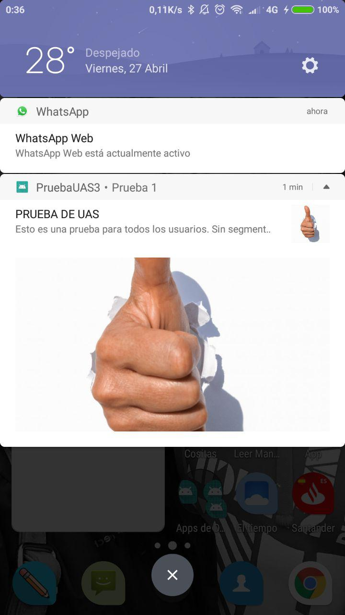
Enviar notificaciones
Se necesita instalar la aplicación con el SDK en un dispositivo móvil.
Podremos enviar notificaciones a todos los usuarios que tengan la aplicación o a un segmento de ellos.
En el caso de querer enviar notificaciones a un segmento de usuarios, necesitaremos esperar a que pasen de las 12 horas de la noche.
Esto es debido a que los usuarios son introducidos en una base de datos, guardados como AUDIENCIA. Esta base de datos se actualiza diariamente. No es necesario esperar 24 horas.

Slide 7
MOBILE PUSH NOTIFICATIONS PLATFORMS
Samuel Pérez Fernández
Beatriz Soro Vegas
Estefanía Martín Rojas
Carolina Tenllado Montes
Álvaro de Palma Rodríguez

Slide 8
1.
Comparación de las tecnologías

Slide 9
General
 | One Signal | Urban Airship
Precio | Gratis
Plataforma | Windows, Linux y MacOS
Interfaz | Protocolos Google, Apple y Web Push
Idioma | Inglés
Documentación | Documentación necesaria para cada lenguaje a utilizar. Muy sencilla. | Documentación para implementar el SDK, muy escueta.

Slide 10
Sistemas operativos
 | One Signal | Urban Airship
Android | Sí
iOS | Sí
Jave ME | No
Windows Phone | Sí
Black Berry | Sí

Slide 11
Sectores
 | One Signal | Urban Airship
Corrreo Electrónico | Sí
Redes sociales | Sí
SMS | No | Sí
Calendario | Sí
Noticias | Sí

Slide 12
IDE
 | One Signal | Urban Airship
Android Studio | Sí
Unity | Sí
Visual Studio | Sí
Cordova | Sí
Phonegap | Sí

Slide 13
Quotations are commonly printed as a means of inspiration and to invoke philosophical thoughts from the reader.

Slide 14
This is a slide title
Here you have a list of items
And some text
But remember not to overload your slides with content
Your audience will listen to you or read the content, but won’t do both.

Slide 15
Big concept
Bring the attention of your audience over a key concept using icons or illustrations

Slide 16
You can also split your content
White
Is the color of milk and fresh snow, the color produced by the combination of all the colors of the visible spectrum.
Black
Is the color of coal, ebony, and of outer space. It is the darkest color, the result of the absence of or complete absorption of light.

Slide 17
In two or three columns
Yellow
Is the color of gold, butter and ripe lemons. In the spectrum of visible light, yellow is found between green and orange.
Blue
Is the colour of the clear sky and the deep sea. It is located between violet and green on the optical spectrum.
Red
Is the color of blood, and because of this it has historically been associated with sacrifice, danger and courage.

Slide 18
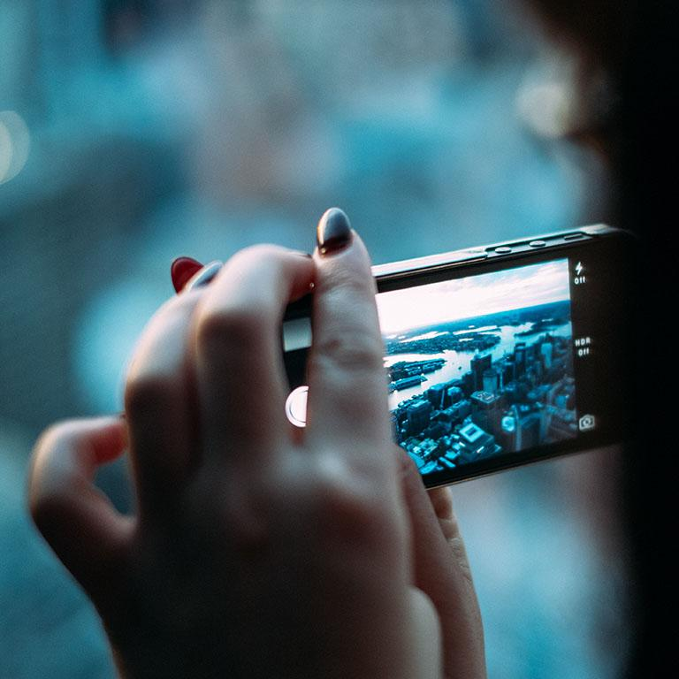
A picture is worth a thousand words
A complex idea can be conveyed with just a single still image, namely making it possible to absorb large amounts of data quickly.

Slide 19
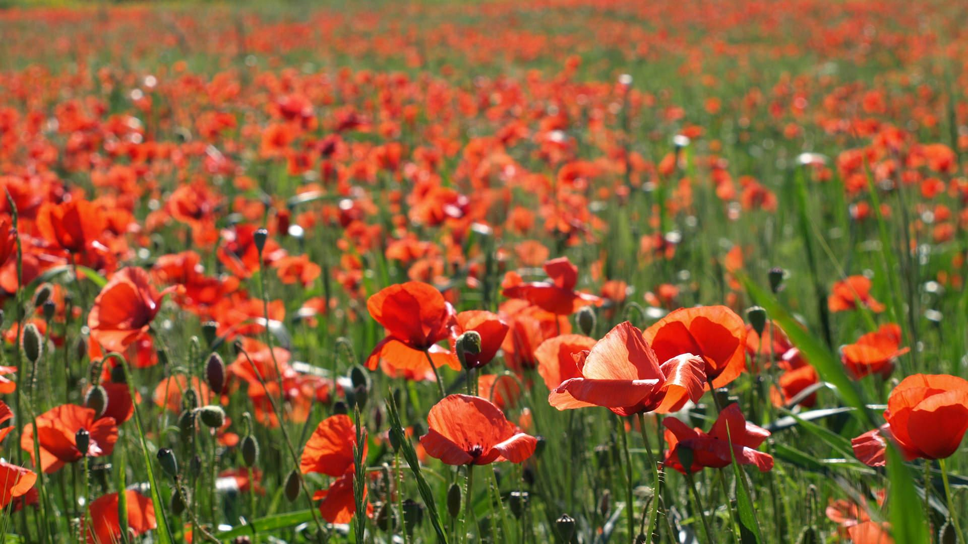
Want big impact?
Use big image.

Slide 20
Use charts to explain your ideas
White
Gray
Black

Slide 21
And tables to compare data
 | A | B | C
Yellow | 10 | 20 | 7
Blue | 30 | 15 | 10
Orange | 5 | 24 | 16

Slide 22
Maps
our office

Slide 23
89,526,124
Whoa! That’s a big number, aren’t you proud?

Slide 24
89,526,124$
185,244 users
100%
That’s a lot of money
And a lot of users
Total success!

Slide 25
Let’s review some concepts
Yellow
Is the color of gold, butter and ripe lemons. In the spectrum of visible light, yellow is found between green and orange.
Blue
Is the colour of the clear sky and the deep sea. It is located between violet and green on the optical spectrum.
Red
Is the color of blood, and because of this it has historically been associated with sacrifice, danger and courage.
Yellow
Is the color of gold, butter and ripe lemons. In the spectrum of visible light, yellow is found between green and orange.
Blue
Is the colour of the clear sky and the deep sea. It is located between violet and green on the optical spectrum.
Red
Is the color of blood, and because of this it has historically been associated with sacrifice, danger and courage.

Slide 26
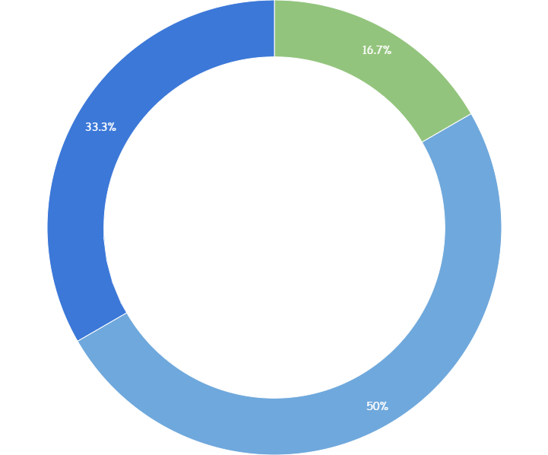
You can copy&paste graphs from Google Sheets

Slide 27
Place your screenshot here
Android project
Show and explain your web, app or software projects using these gadget templates.

Slide 28
Place your screenshot here
iPhone project
Show and explain your web, app or software projects using these gadget templates.

Slide 29
Place your screenshot here
Tablet project
Show and explain your web, app or software projects using these gadget templates.

Slide 30
Place your screenshot here
Desktop project
Show and explain your web, app or software projects using these gadget templates.

Slide 31
thanks!
Any questions?
You can find me at
@username
user@mailme

Slide 32
Credits
Special thanks to all the people who made and released these awesome resources for free:
Presentation template by SlidesCarnival
Photographs by Unsplash

Slide 33
Presentation design
This presentation uses the following typographies and colors:
Titles: Walter Turncoat
Body copy: Sniglet
You can download the fonts on these pages:
https://www.fontsquirrel.com/fonts/walter-turncoat
https://www.fontsquirrel.com/fonts/sniglet
White #FFFFFF
You don’t need to keep this slide in your presentation. It’s only here to serve you as a design guide if you need to create new slides or download the fonts to edit the presentation in PowerPoint®

Slide 34
SlidesCarnival icons are editable shapes.
This means that you can:
Resize them without losing quality.
Change fill color and opacity.
Isn’t that nice? :)
Examples:

Slide 35
😉
Now you can use any emoji as an icon!
And of course it resizes without losing quality and you can change the color.
How? Follow Google instructions https://twitter.com/googledocs/status/730087240156643328
✋👆👉👍👤👦👧👨👩👪💃🏃💑❤😂😉😋😒😭👶😸🐟🍒🍔💣📌📖🔨🎃🎈🎨🏈🏰🌏🔌🔑 and many more...

Slide 36
Extra graphics

